Slide 1
Clinically useful early detection of Parkinson's Disease using uncertainty-aware classification with CNNs
Master Thesis
Presented By: Anurag Sundar
Supervised by: Dr. Markus Wenzel

Slide 2
Goal of the thesis
Construction of an uncertainty-aware CNN(Convolutional Neural Network) model for early Parkinson’s disease detection.
Uncertainty-aware: The model should be able to accurately quantify uncertainty for each prediction.
In order to help assist medical professionals make efficient and informed decisions.

Slide 3
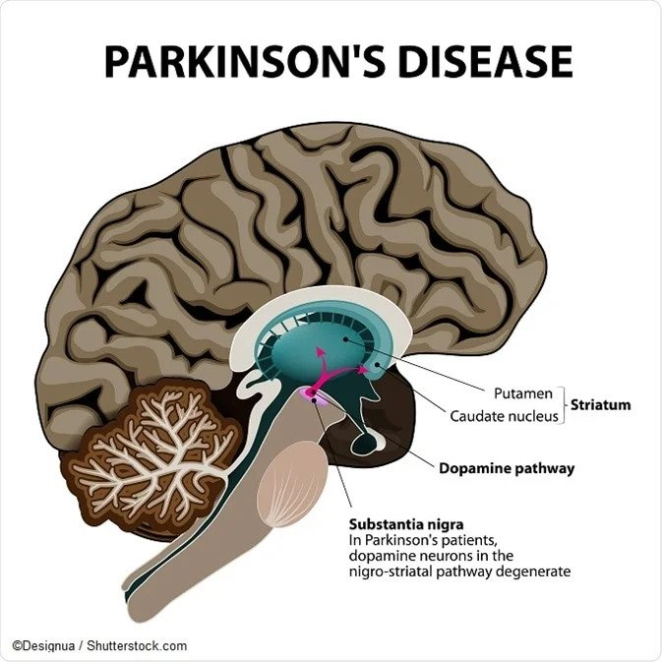
What is Parkinson’s Disease?
Causes loss of mental and motor functions
Dopamine affects movement, motivation, and pleasure in the human brain
Brain scanned using FP-CIT SPECT technology to detect dopamine activity.

Slide 4
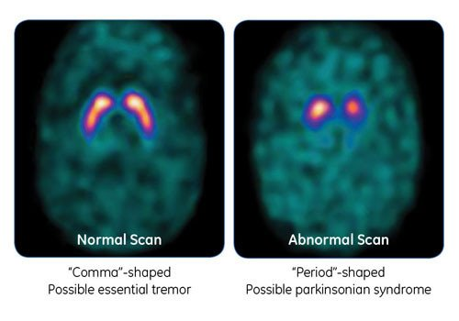
Parkinson’s disease detection
Area of the brain: Striatum

Slide 5
Data Description
2D grayscale brain scan images from Universitätsklinikum Hamburg-Eppendorf(UKE)
1290 Total images: 645 original grayscale images and 645 smoothened copies.
2D image dimension: (109,91)
2 Classes:
HC - Healthy Control(0)
PD - Parkinson’s Disease(1)

Slide 6
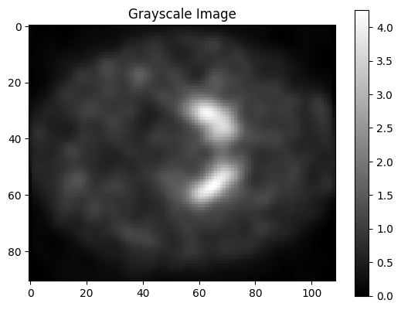
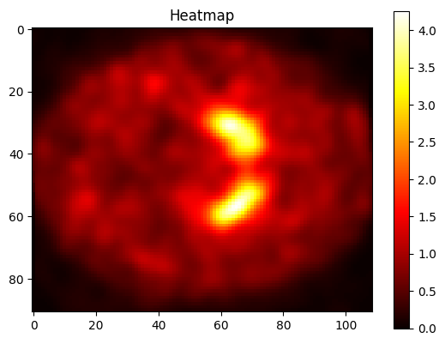
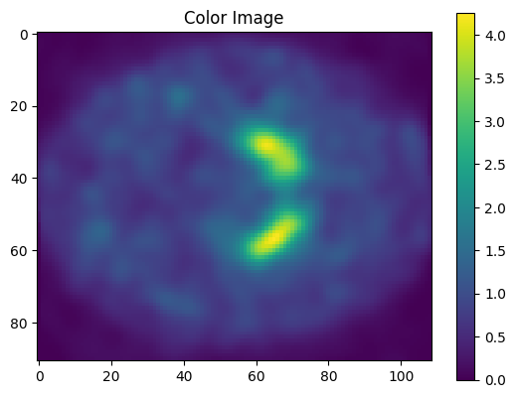
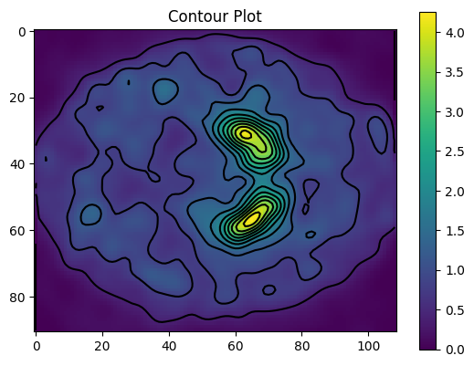

Slide 7
Uncertainty-aware techniques:
Methods:
Spectral-Normalised Neural gaussian Process(SNGP)
Monte Carlo Dropout
Deep Ensemble
Temperature Scaling
Baseline method:
A basic CNN classification model with no special uncertainty-aware techniques applied.

Slide 8
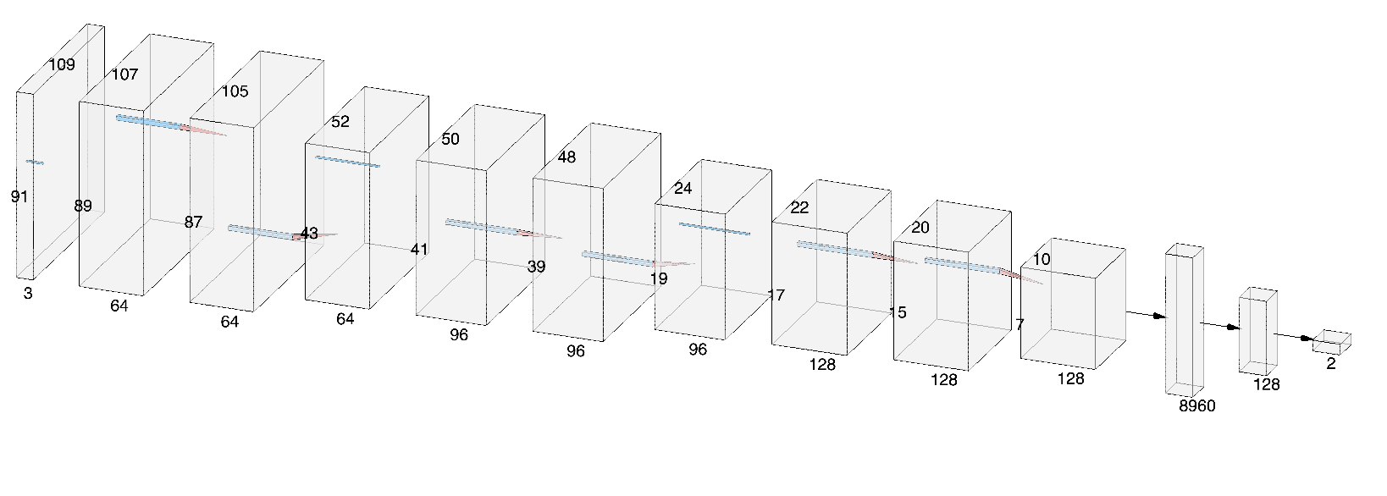
Basic CNN Architecture(baseline model):

Slide 9
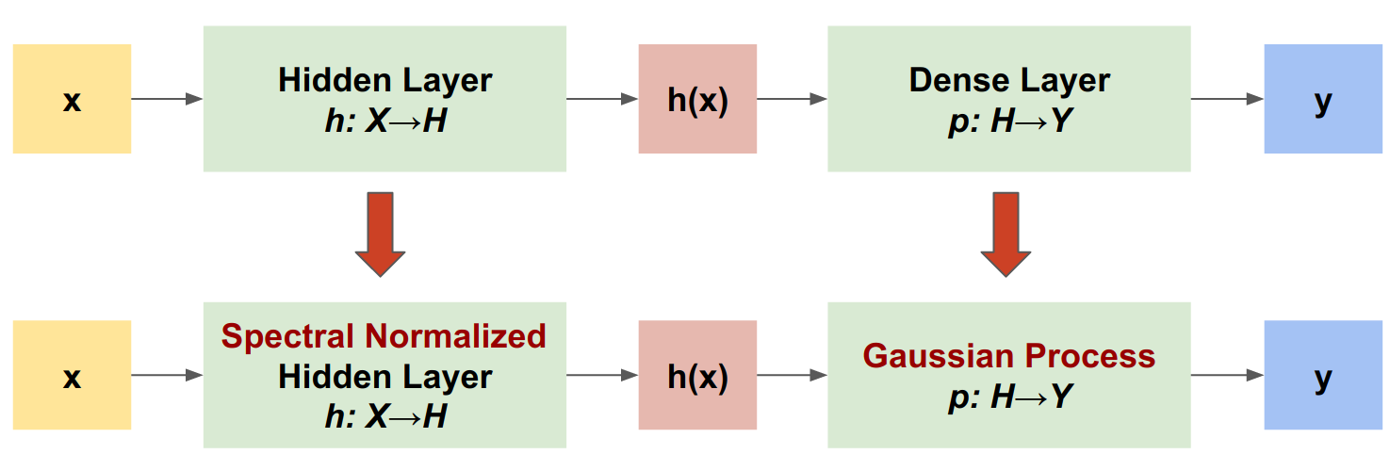
SNGP

Slide 10
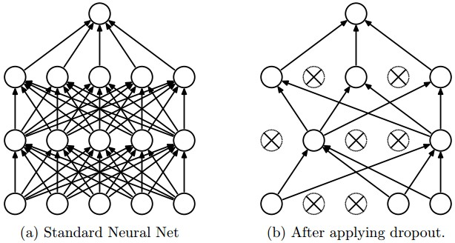
Monte-Carlo Dropout
25% neurons randomly dropped during training and inference.
100 forward passes during Inference.

Slide 11
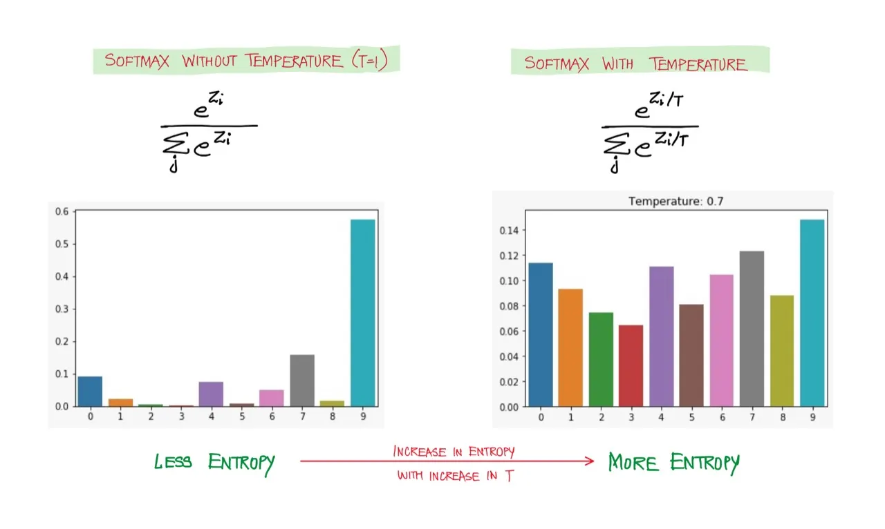
Temperature Scaling
Temperature parameter
Calibrating raw model outputs(logits)
More realistic predictions

Slide 12
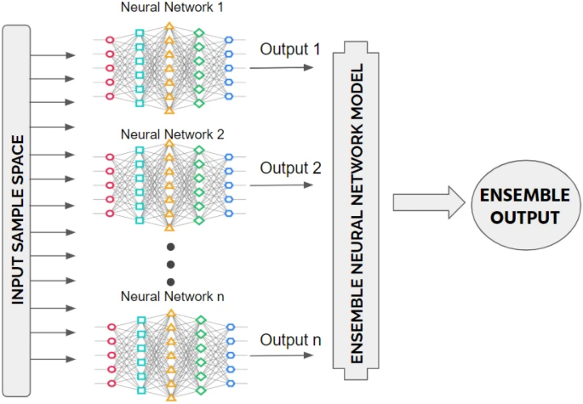
Deep Ensemble
Aggregate of 3 models:
Basic CNN model
Monte Carlo Model
Batch Norm Model(3rd DE Model)

Slide 13
Procedure
The following procedure or flow of events is followed for all the above mentioned methods:
Data processing and augmentation.
Data splitting
Model training and validation
Model evaluation(Classification and uncertainty)

Slide 14
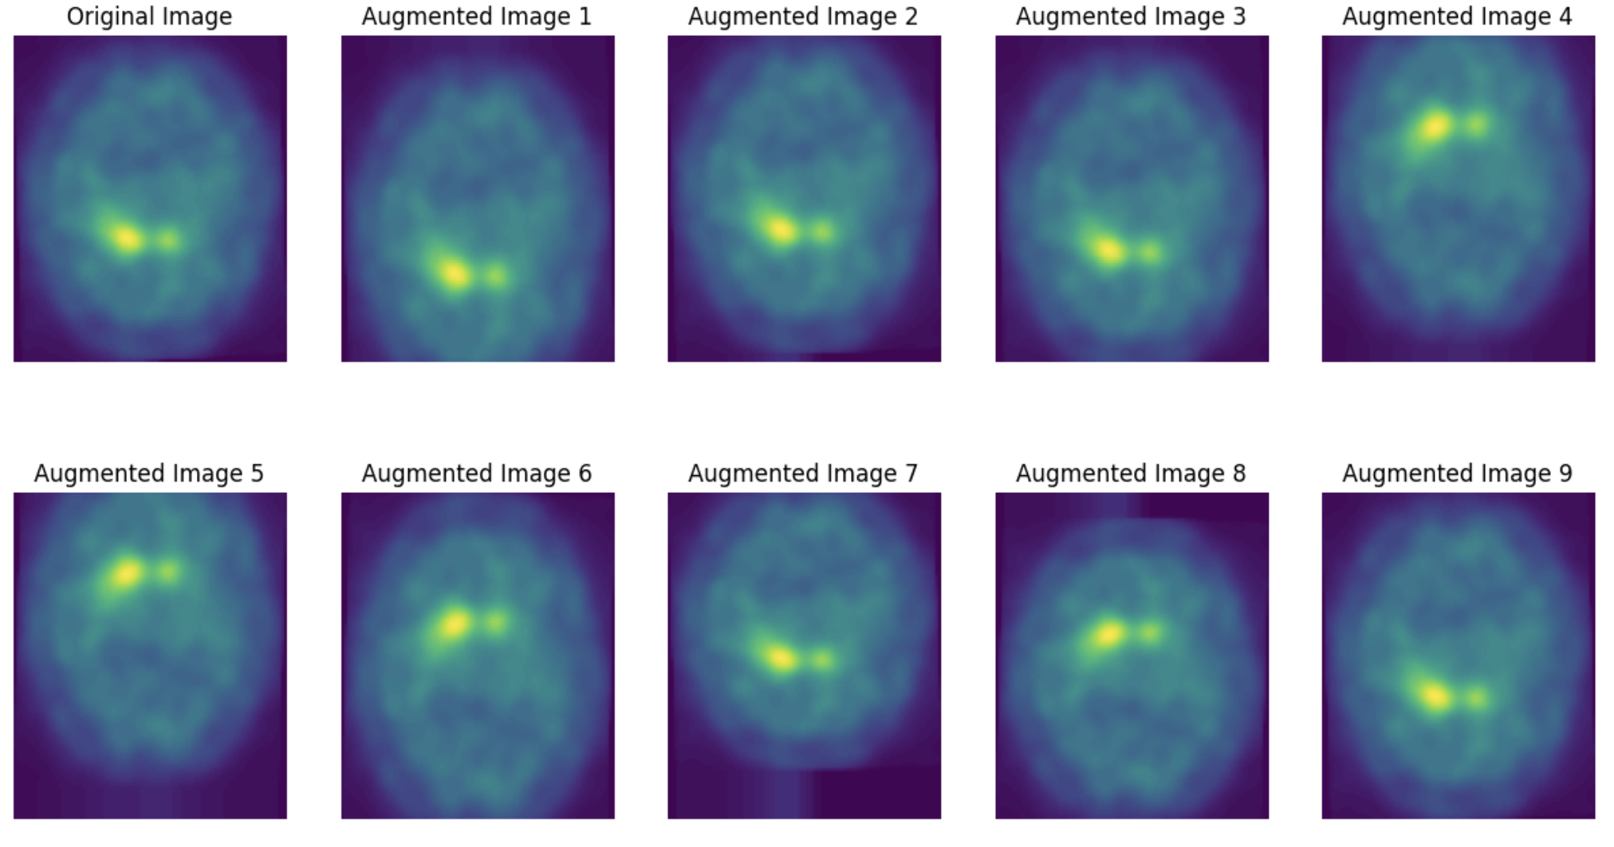
Data Processing and Augmentation

Slide 15
Data Splitting
Dataset | Percentage | Number of Images | Purpose
Train | Roughly 70% | 904 | Model Training
Validation | Roughly 15% | 200 | Model Validation
Test | Roughly 15% | 186 | Model Evaluation

Slide 16
Model Training and Validation
Setting | Value
Epochs | 100
Loss Function | Sparse Categorical Cross Entropy
Metrics | Sparse Categorical Accuracy
Optimizer | Adam(learning rate: 1x10^-4)

Slide 17
Model Evaluation/Results
For evaluating the uncertainty quantification performance of the different methods , we will look at the following plots for each of them:
UMAP Projection Entropy plot
Categorical Entropy plot
Threshold analysis on Categorical Entropy plot

Slide 18
UMAP PROJECTION ENTROPY PLOTS

Slide 19
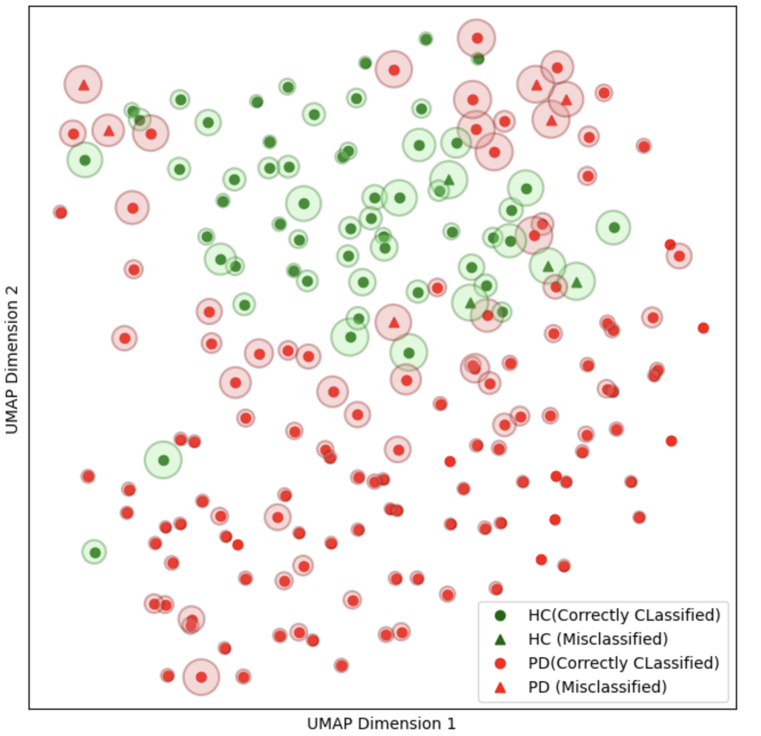
Basic CNN Model

Slide 20
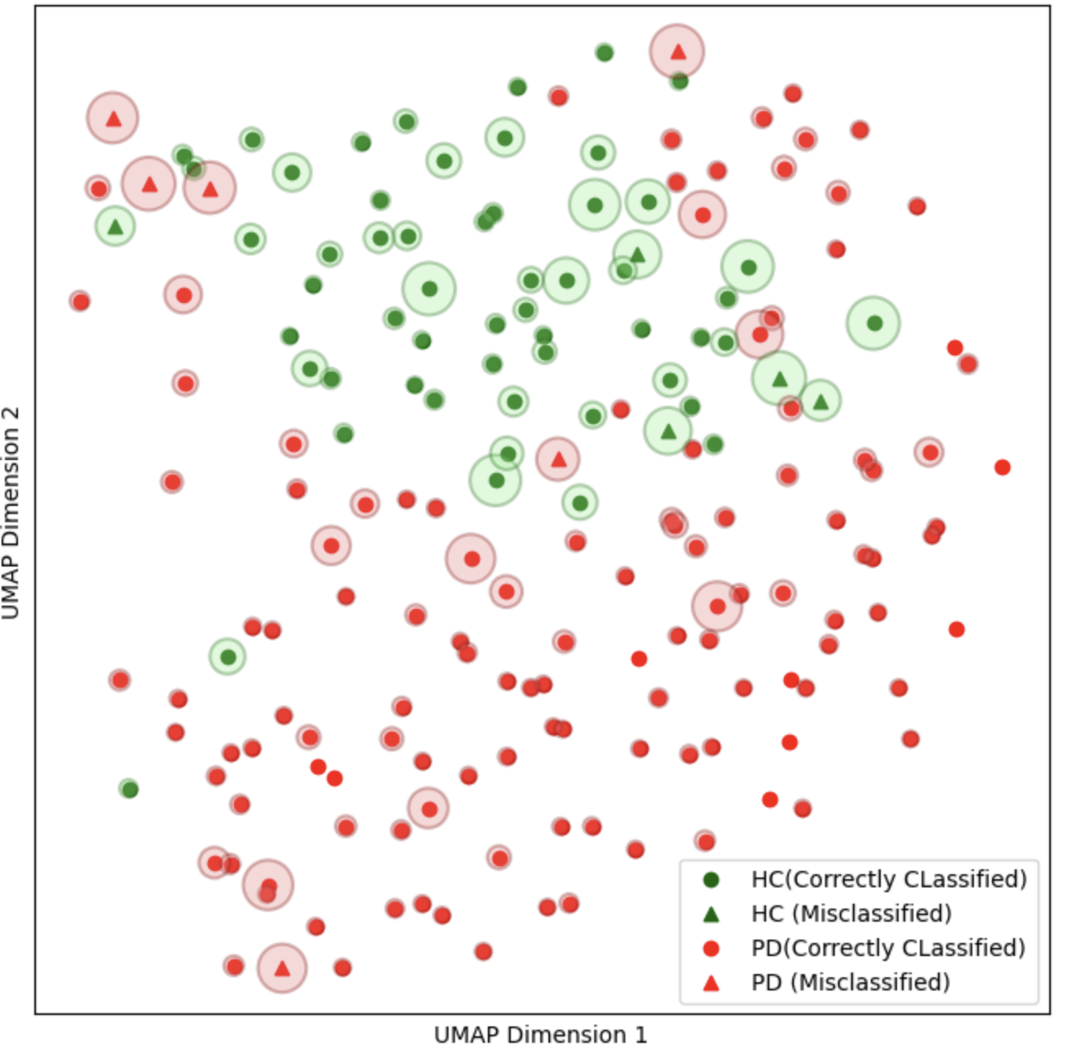
Temp Scaling Model

Slide 21
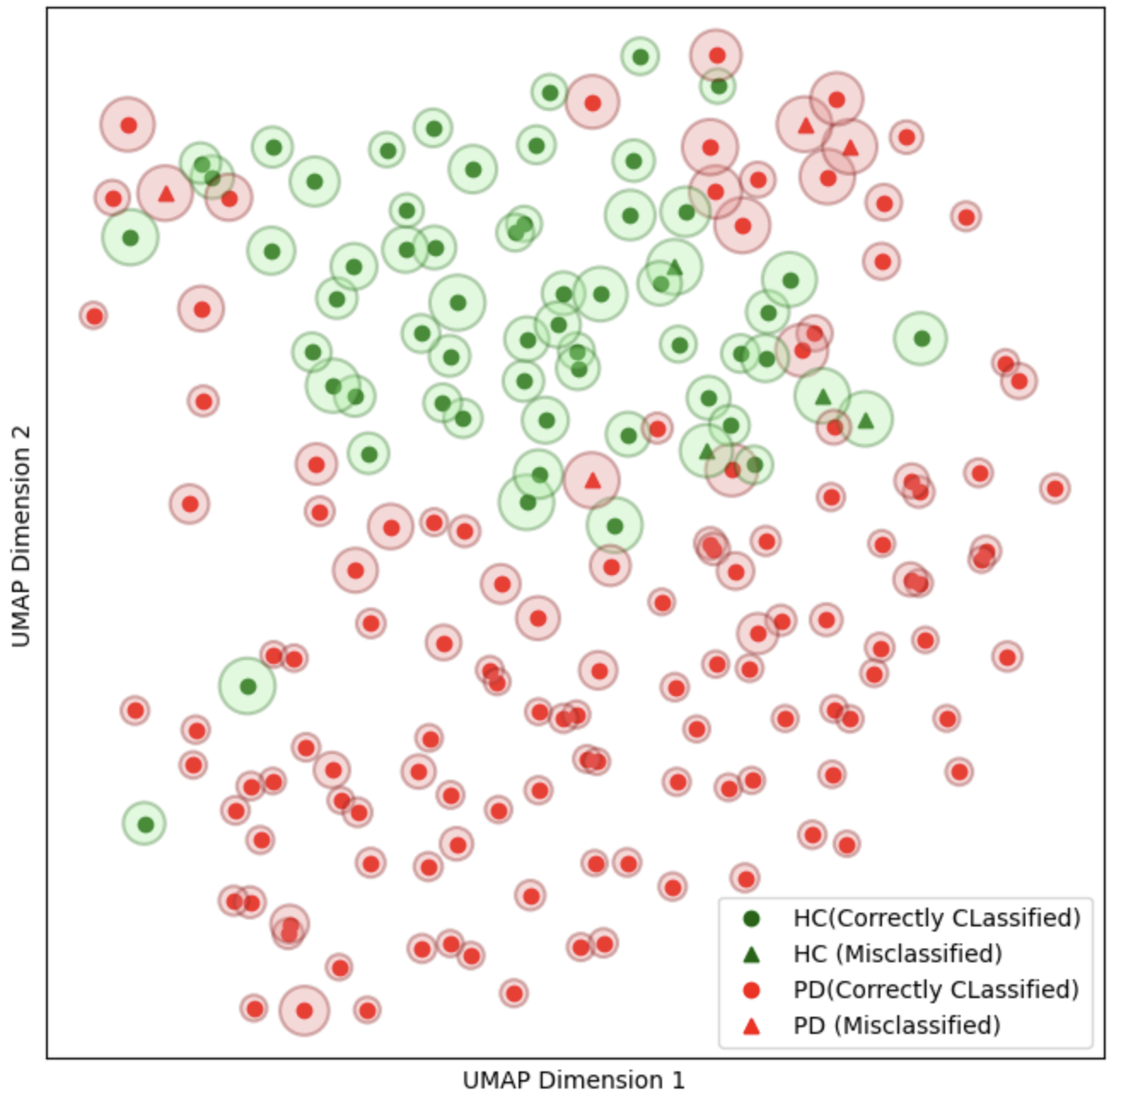
SNGP Model

Slide 22
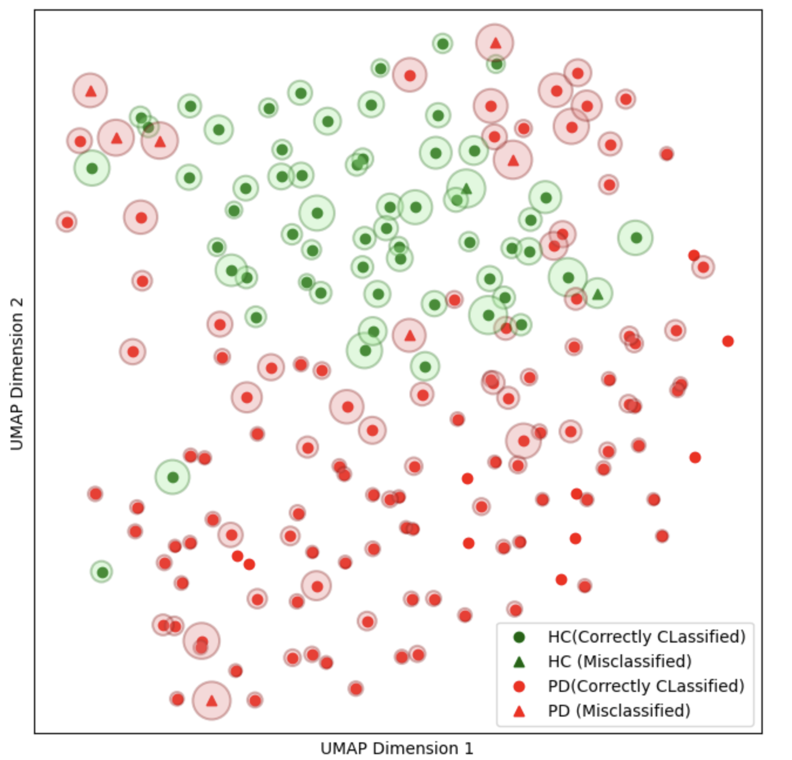
MC Dropout Model

Slide 23
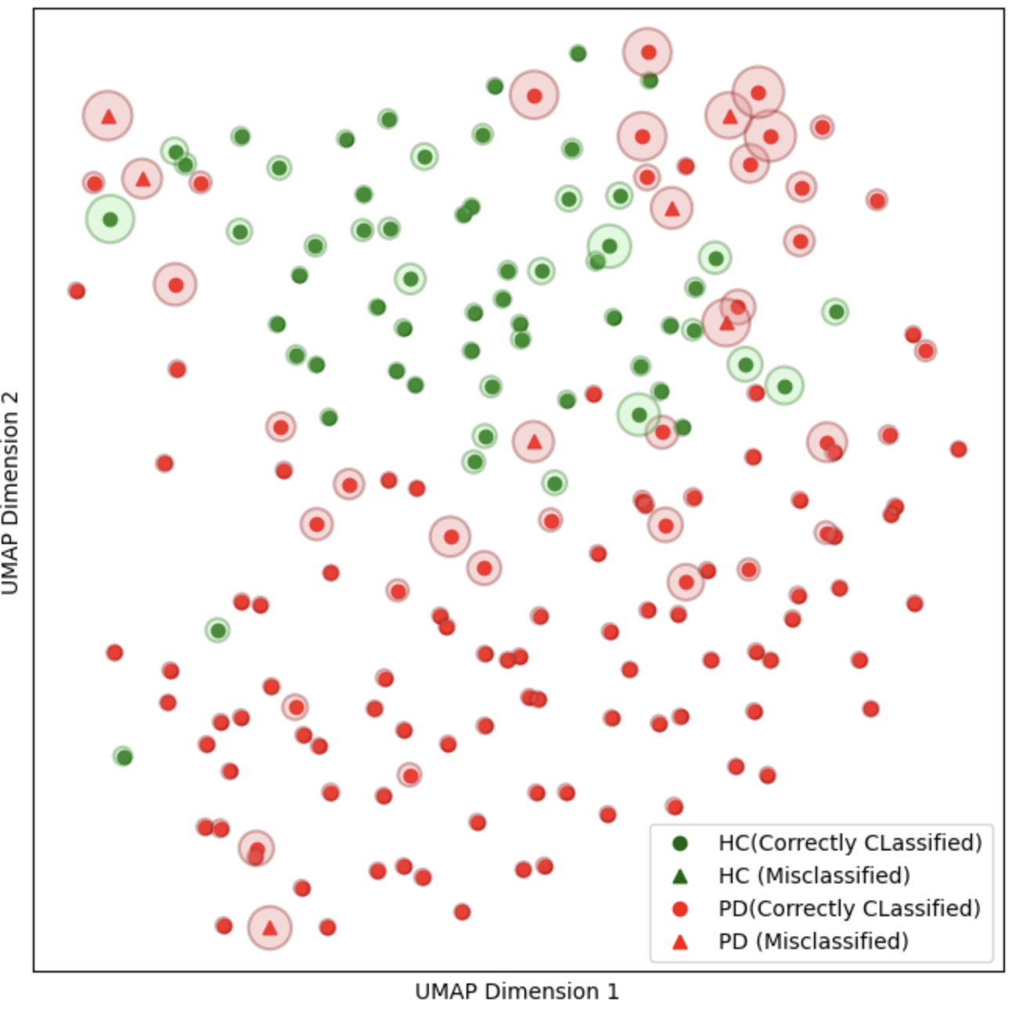
3rd DE Model

Slide 24

Deep Ensemble

Slide 25
CATEGORICAL ENTROPY PLOTS

Slide 26
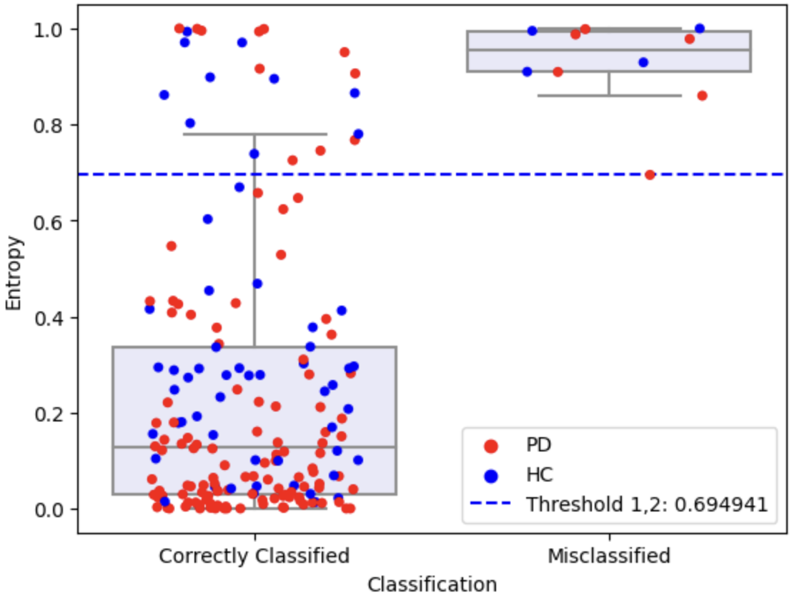
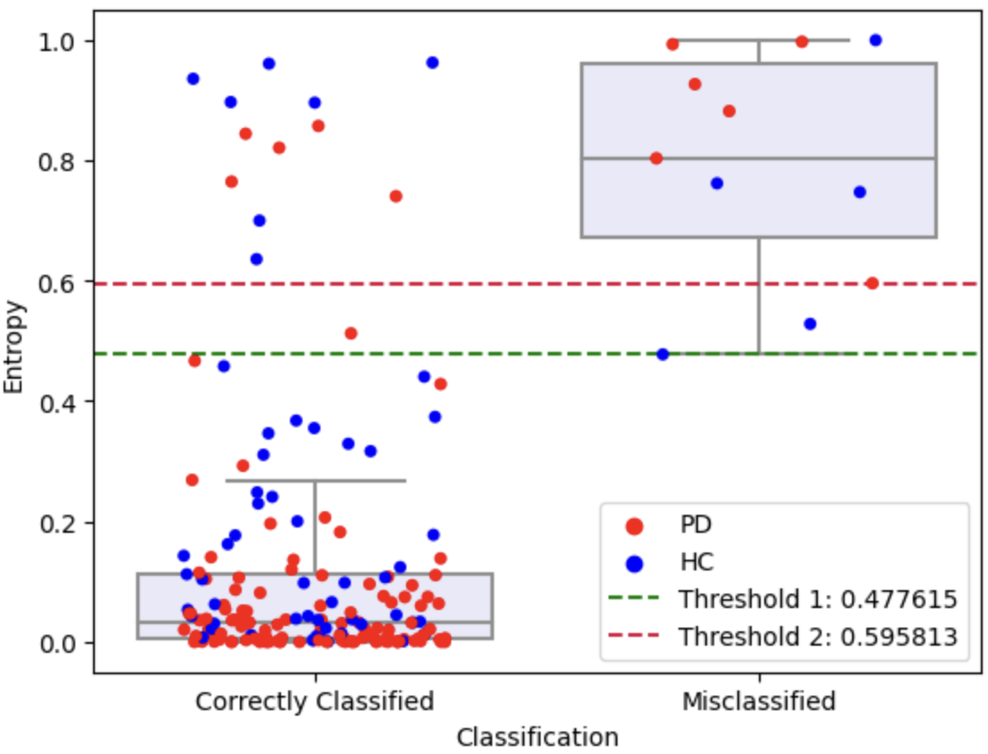
Base CNN Model
Temp Scaling Model

Slide 27
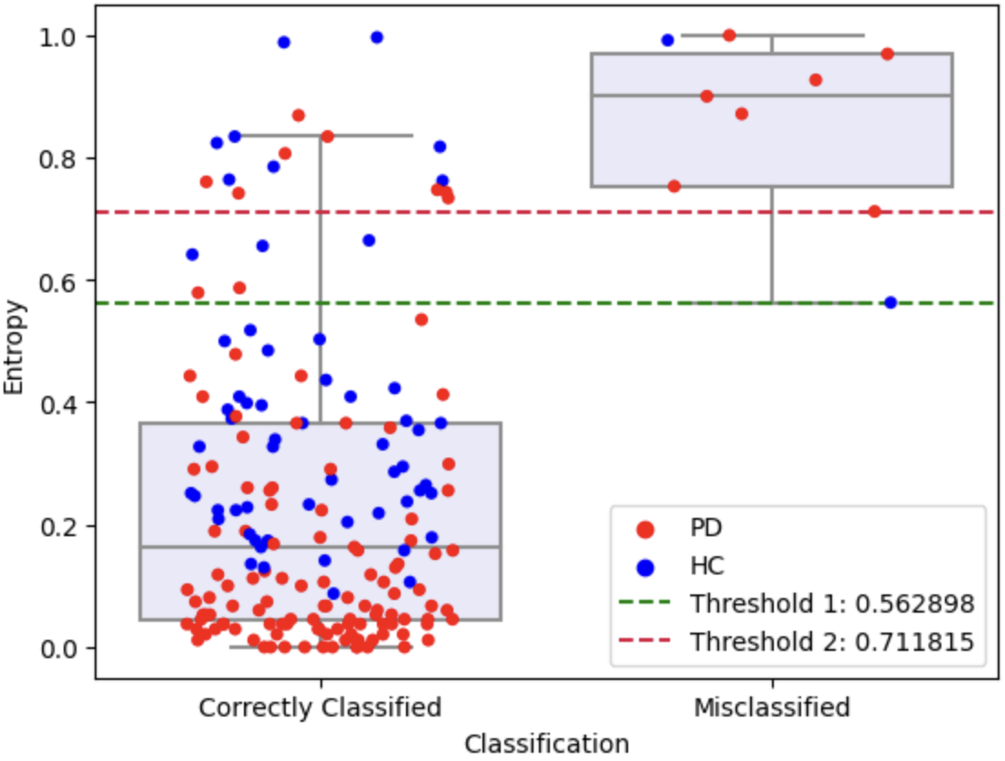
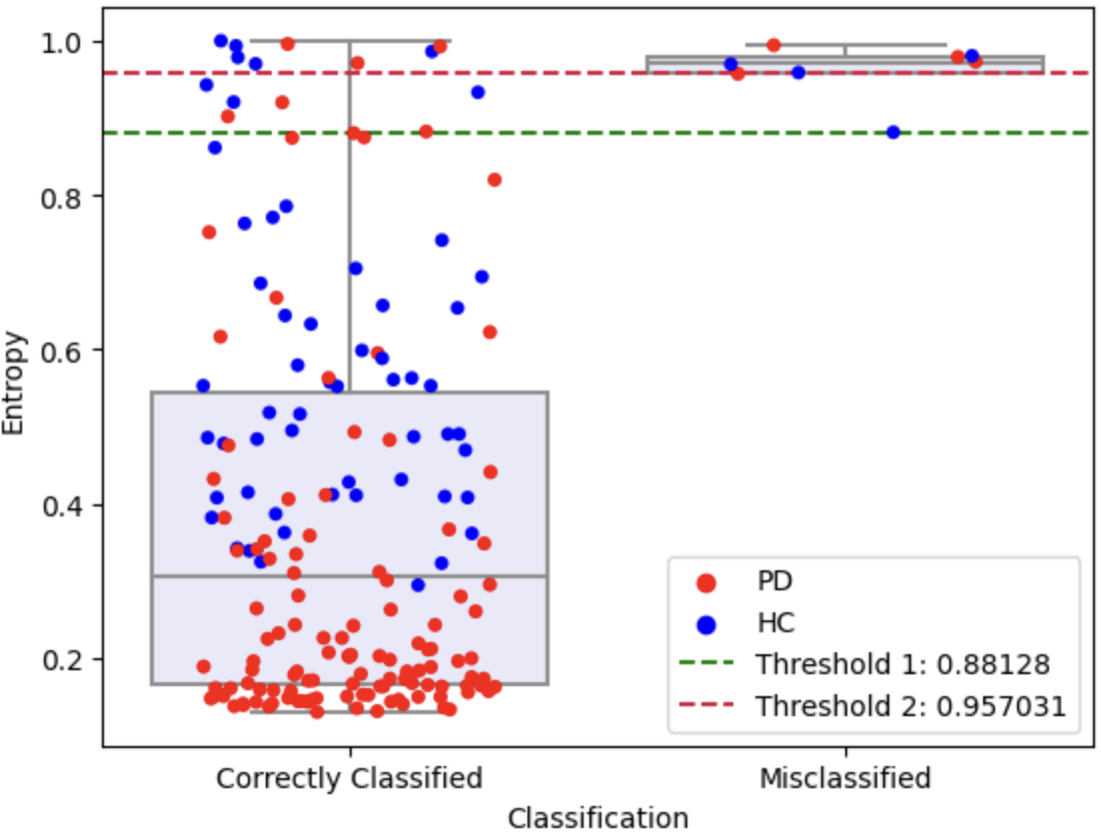
MC Dropout Model
SNGP Model

Slide 28
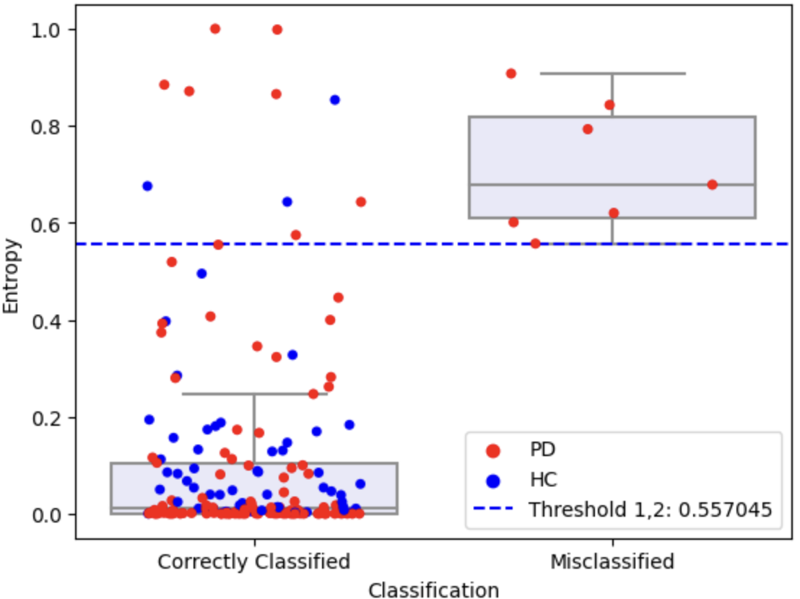
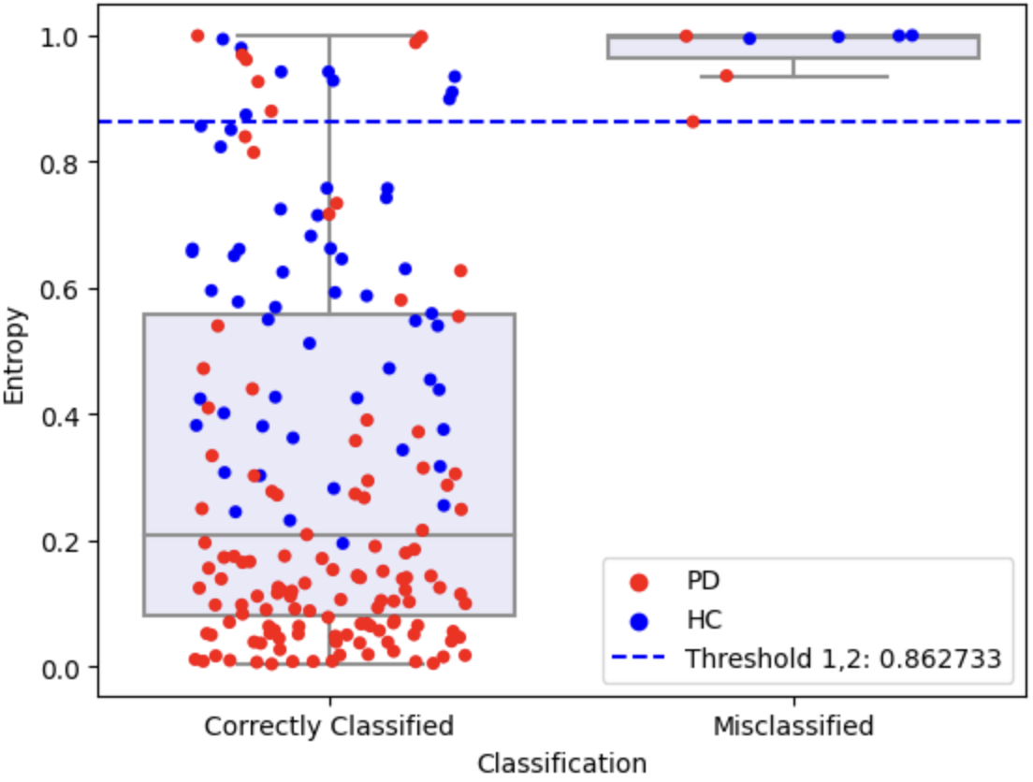
3rd DE Model
Deep Ensemble

Slide 29
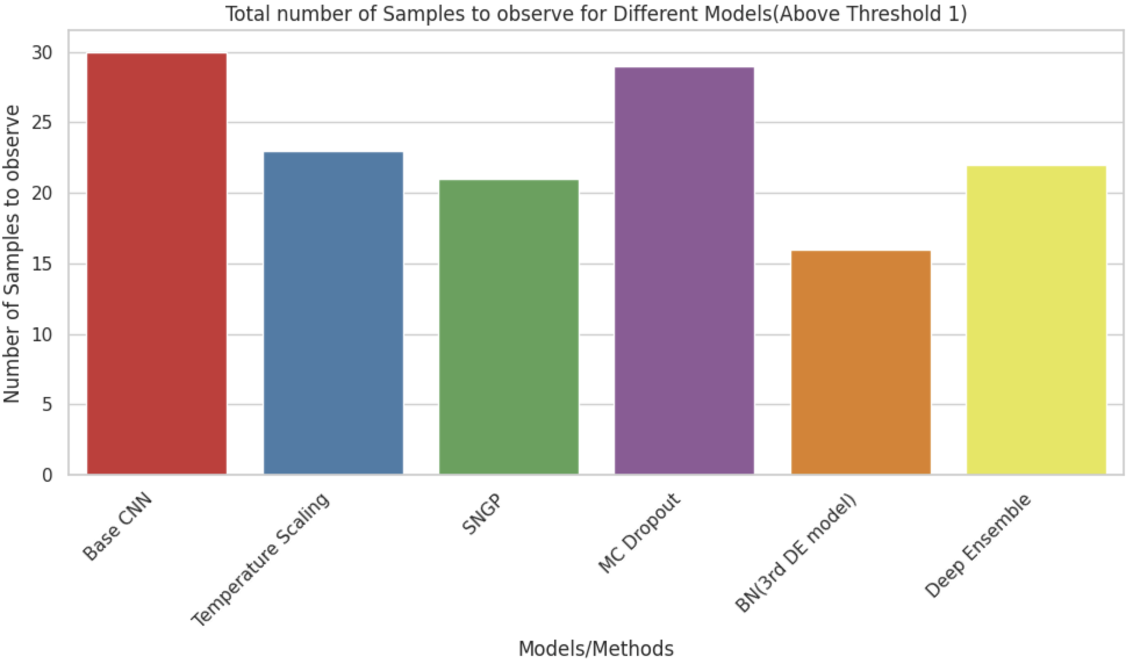

Slide 30
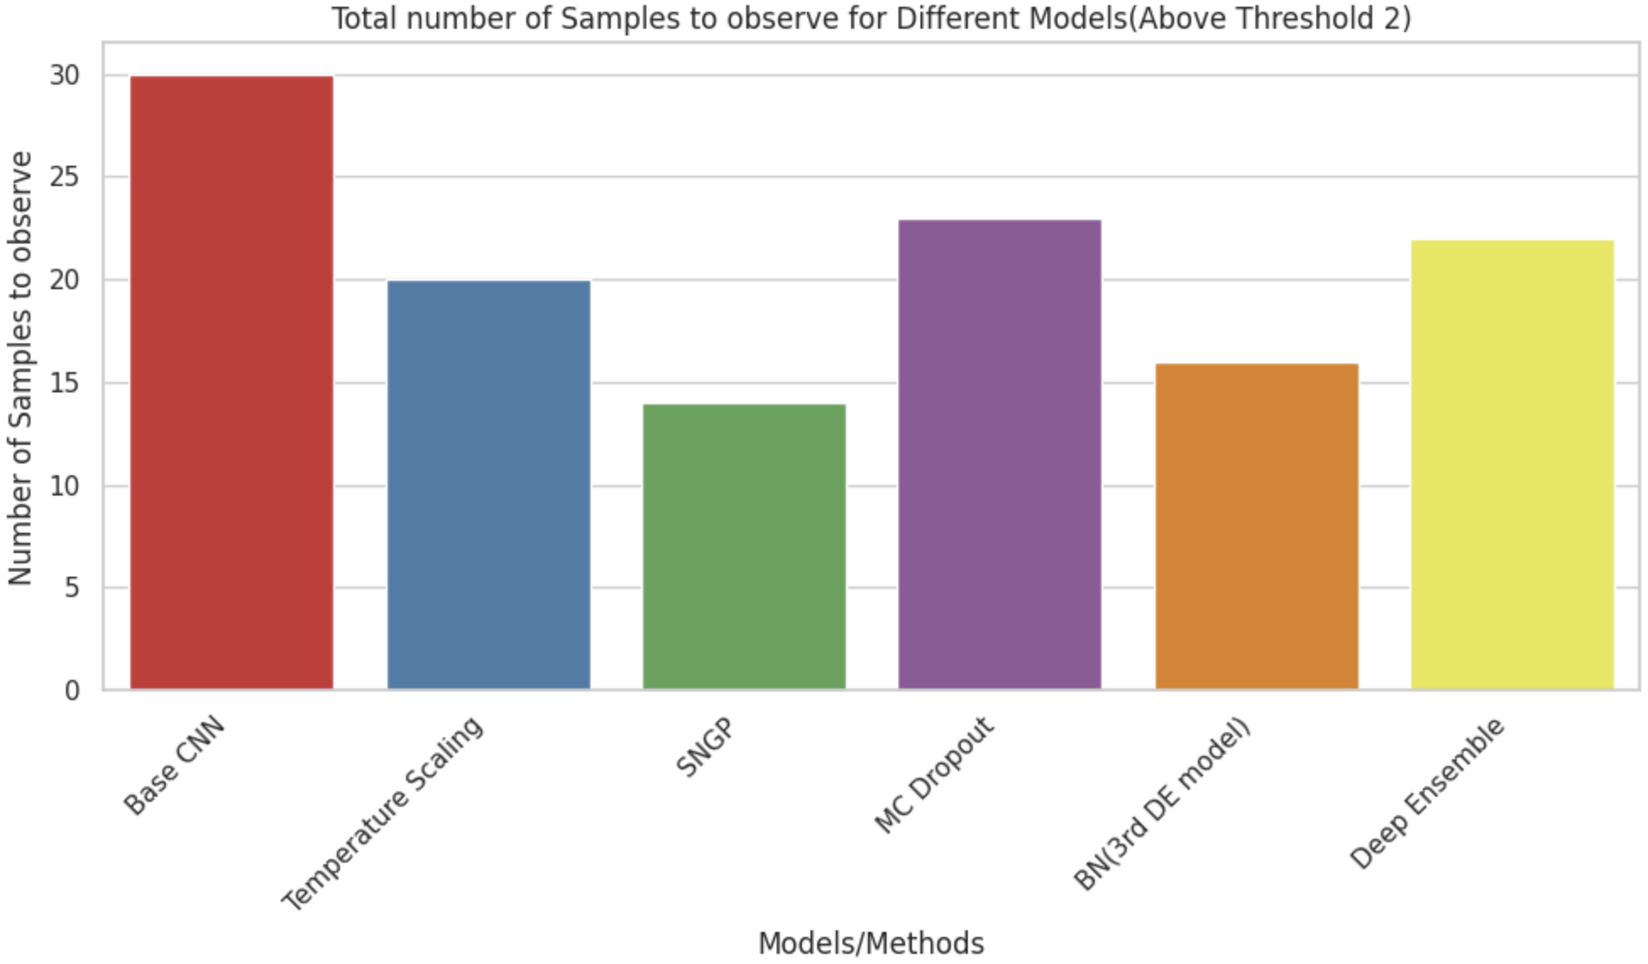

Slide 31
Conclusions
Best uncertainty quantification results for Threshold 1: BN model(3rd DE model)
Best uncertainty quantification results for Threshold 2: SNGP model
All the models are inherently quite confident for PD cases as compared to the HC cases.
Batch normalisation played a crucial role in enhancing the classification and uncertainty quantification performance.
SNGP model was also crucial in making the predictions more distance aware.

Slide 32
Applications
Decision Support: Uncertainty-aware models can serve as decision support tools for healthcare professionals.
Early Detection: Early parkinson’s disease detection in uncertain cases.
Risk Assessment: Risk assessment based on uncertainty of prediction.
Robustness to Noisy/Incomplete data: Uncertainty estimates can be made even for incomplete or noisy data.

Slide 33
References
[1] American Parkinson’s disease association: https://www.apdaparkinson.org/article/what-is-a-datscan-and-should-i-get-one/
[2] Uncertainty-aware Deep Learning with SNGP: https://www.tensorflow.org/tutorials/understanding/sngp
[3] https://pubmed.ncbi.nlm.nih.gov/22529704/
[4] https://www.researchgate.net/figure/TRODAT-1-SPECT-image-of-healthy-volunteer-control-demonstrating-ROI-analysis-for_fig1_8036468
[5] https://www.news-medical.net/health/Parkinsons-Disease-Pathophysiology.aspx
[6] Automatic classification of dopamine transporter SPECT: deep convolutional neural networks can be trained to be robust with respect to variable image characteristics

Slide 34
THANK YOU

